Slide 1

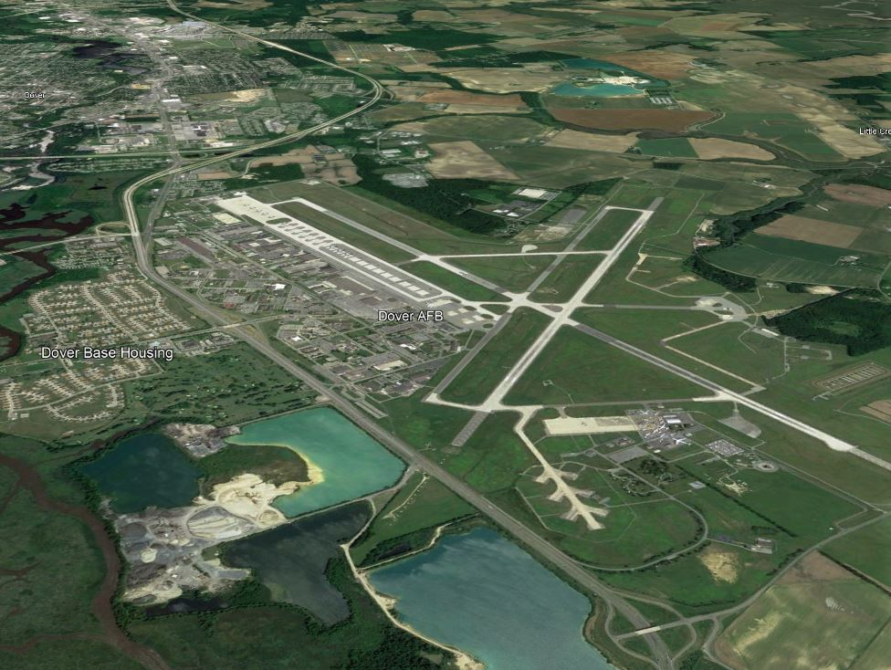

DAFB Compatible Use Study –
Borrow Pit Interactive Planning Session #2
October 4, 2022

Slide 2
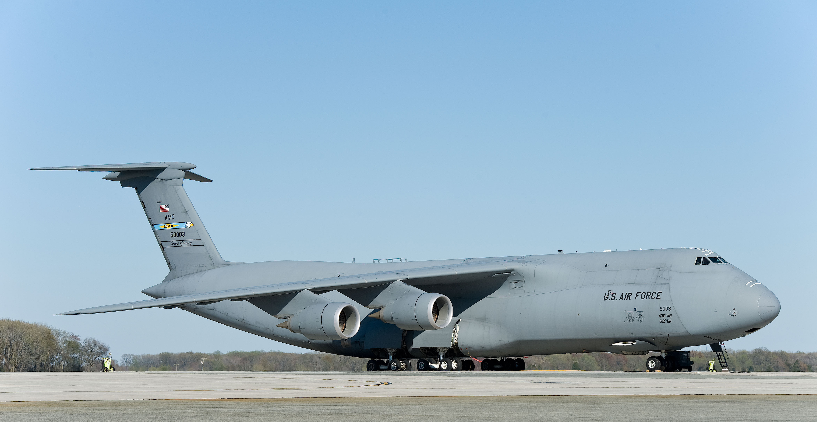
Agenda
Project Summary
Discussion of suggestions
Pro/Cons/Compliance
Maintenance
Funding opportunities
Mechanisms to implement ideas
Prioritization
Timeline
Photo courtesy of bing.com
https://deldot.gov/projects/Studies/dafb/index.shtml

Slide 3
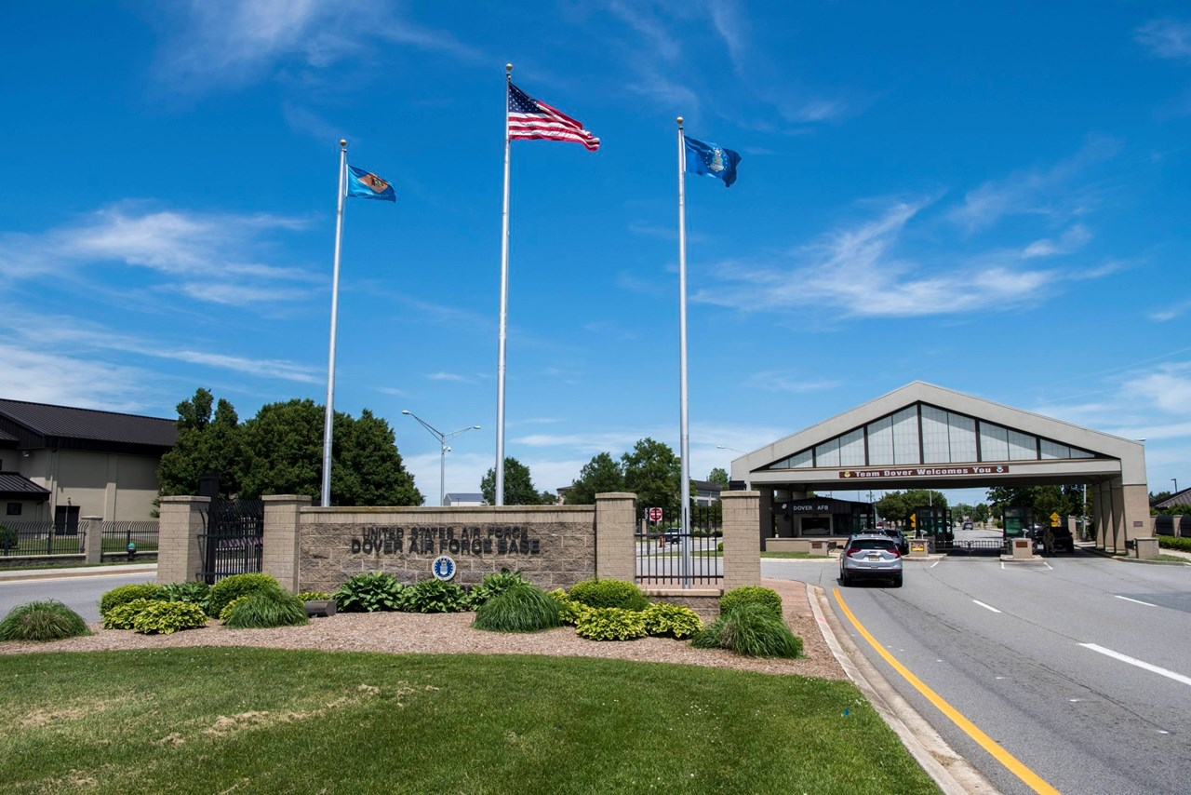
Project Summary
Vital role in national defense
Serve as major economic engines
Examine surrounding areas of the military installation
Support DAFB
Enhance communication
Protect public and DAFB personnel
Sustaining economic vitality of the surrounding communities
Photo courtesy of bing.com
https://deldot.gov/projects/Studies/dafb/index.shtml

Slide 4
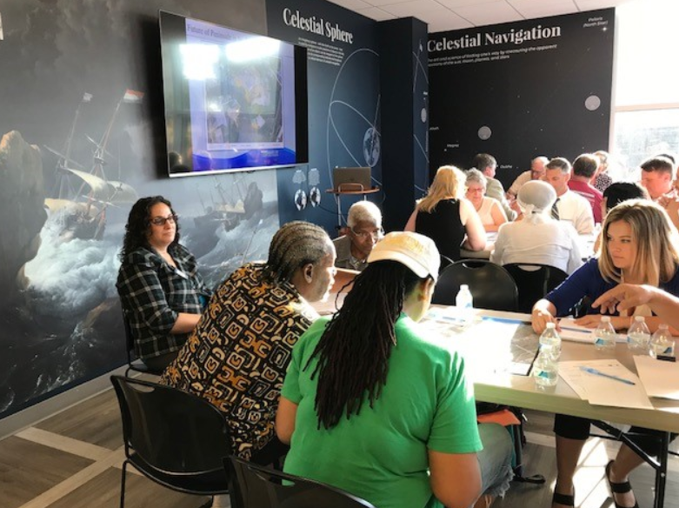

INTERACTIVE PLANNING SESSIONS
September 27th AND October 4th, 2022
4:00 – 7:00 p.m.
DelDOT Administration Building
South Entrance
Delaware Conference Room
https://deldot.gov/projects/Studies/dafb/index.shtml

Slide 5
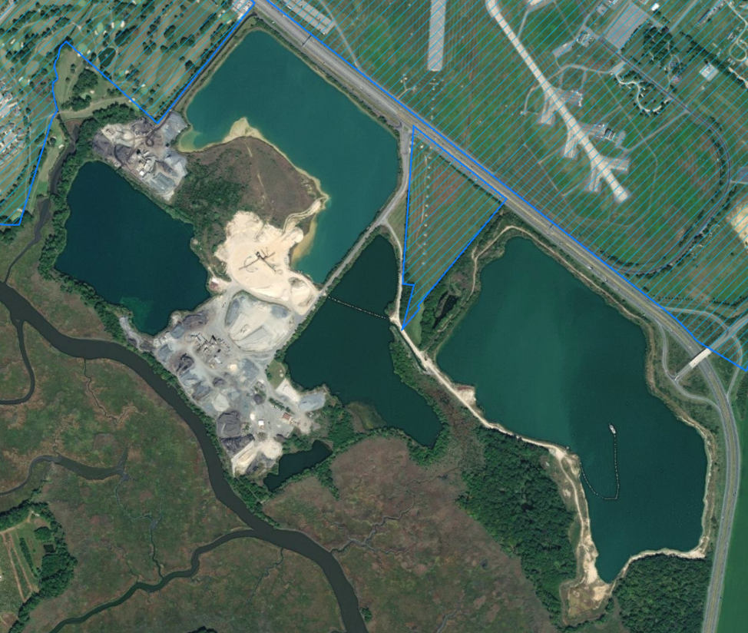

Photo courtesy of bing.com
https://deldot.gov/projects/Studies/dafb/index.shtml

Slide 6
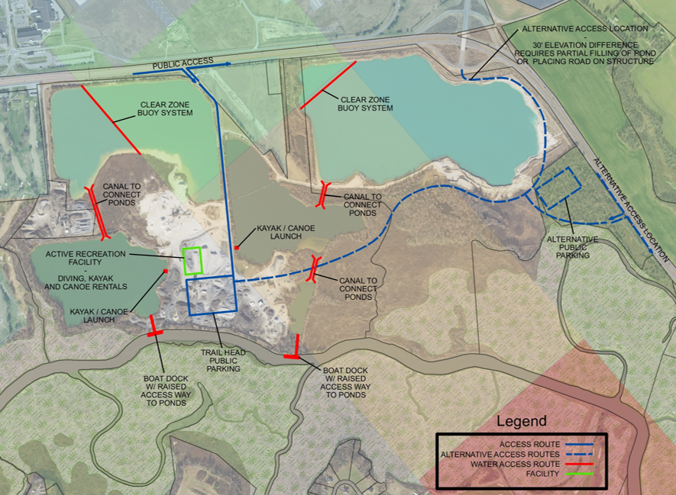
Active Recreation
Pros/Cons/Compliance
Maintenance
Funding opportunities
Mechanisms to implement ideas
Prioritization
https://deldot.gov/projects/Studies/dafb/index.shtml

Slide 7
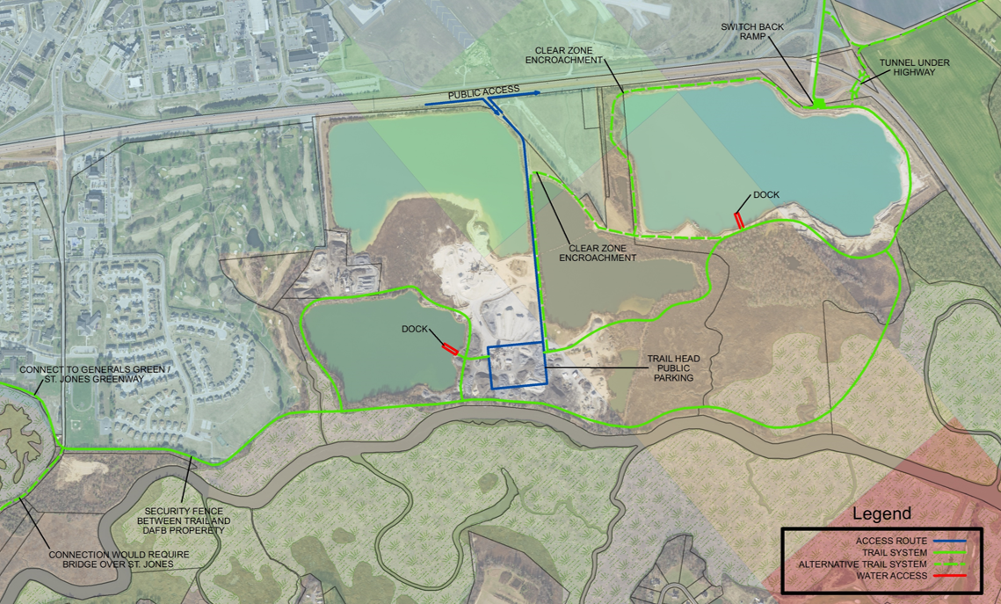
Passive Recreation
Pros/Cons/
Compliance
Maintenance
Funding opportunities
Mechanisms to implement ideas
Prioritization
https://deldot.gov/projects/Studies/dafb/index.shtml

Slide 8
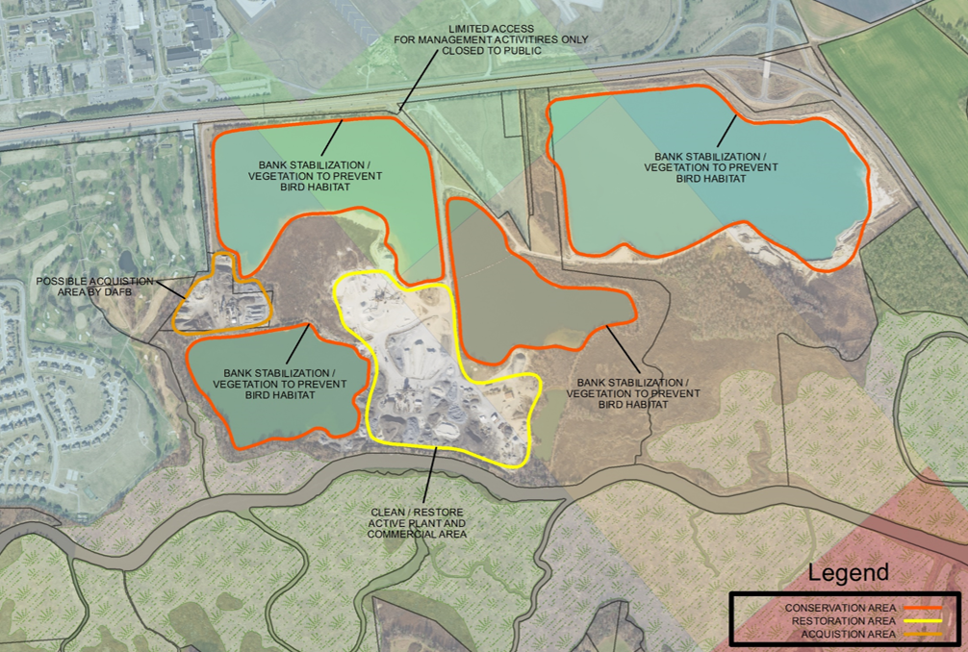
Conservation
Pros/Cons/Compliance
Maintenance
Funding opportunities
Mechanisms to implement ideas
Prioritization
https://deldot.gov/projects/Studies/dafb/index.shtml

Slide 9
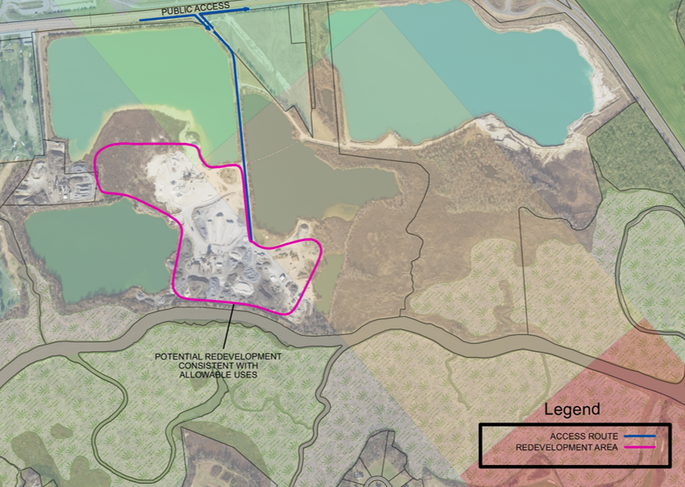
Economic Growth and Industry Opportunities
Pros/Cons/Compliance
Maintenance
Funding opportunities
Mechanisms to implement ideas
Prioritization
https://deldot.gov/projects/Studies/dafb/index.shtml

Slide 10
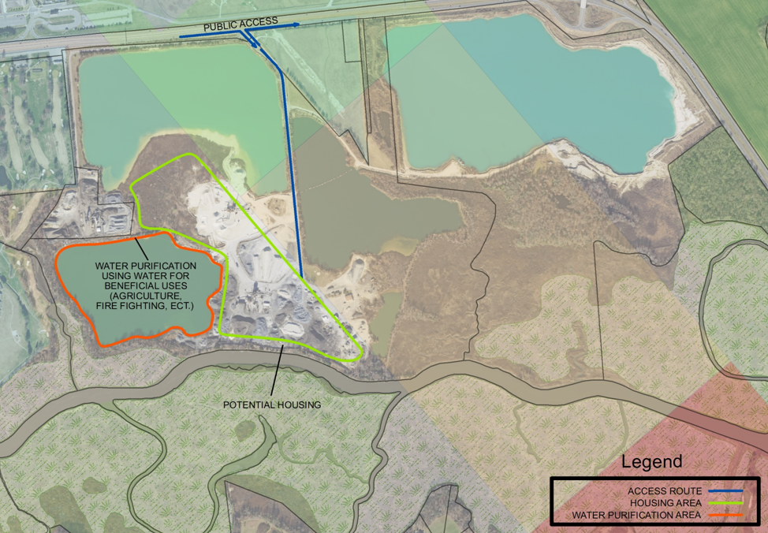
Additional Ideas
Pros/Cons/Compliance
Maintenance
Funding opportunities
Mechanisms to implement ideas
Prioritization
https://deldot.gov/projects/Studies/dafb/index.shtml

Slide 11
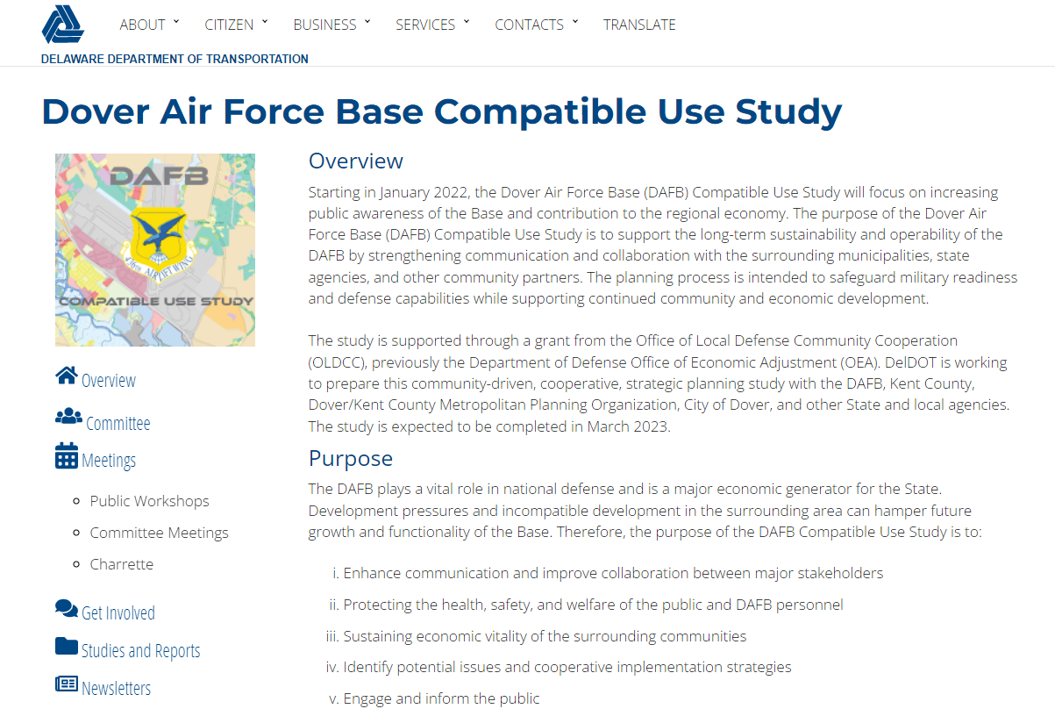
Webpage and Mapping
Webpage
https://deldot.gov/projects/Studies/dafb/index.shtml
Mapping
https://centuryeng.maps.arcgis.com/apps/webappviewer3d/index.html?id=ca47f7ea440448e19a75626e5be9fbc2

Slide 12
Study Timeline
Data Gathering Completed
Base Installation Tour April 25, 2022
First Public Workshop May 17, 2022
Stakeholder Interviews August 2022
Conflict Identification September 2022
Strategies September 2022
Interactive Planning Sessions September/October 2022
Second Public Workshop November 2022
Final Report December 2022
We are here
https://deldot.gov/projects/Studies/dafb/index.shtml

Slide 13

Please exit this video and click on the link to access a quick questionnaire on Active Recreation possibilities
THANK YOU!
https://deldot.gov/projects/Studies/dafb/index.shtml

